Slide 1

Austin Housing EDA
Greyson, Thi, and Jon
SMU Data Analytics

Slide 2





Project Overview
Objective
Data
Sources, Cleaning, Duplicates, Outliers, Missing Data
Analysis
Questions Answered and Actionable Insights
Limitations and Future Work
Q&A

Slide 3
Objective
Conduct an in-depth review of the Austin Housing Market data and determine what variables impact price, sales frequency, timing for selling versus buying, and other factors that play a role in the housing market.
Inspiration:
The population of Austin, TX is growing exponentially. How does this growth affect the housing market and its participants

Slide 4
Objective
Research Questions:
What are different trends in the housing market?
How has the frequency of sales been affected by year? Have they increased or decreased?
What type of houses are being purchased? (single,
family, condo, multifamily)
What area of Austin is the housing market growing in?
Does the market favor investors/buyers or sellers?

Slide 5
Data and Analysis
Sources
U.S Census, Google Maps API, Kaggle
Cleaning
Outliers
Limited to the city of Austin
Removed extreme price and size outliers outliers
Missing Data
Data for 2021 homes sales was limited in this data set

Slide 6
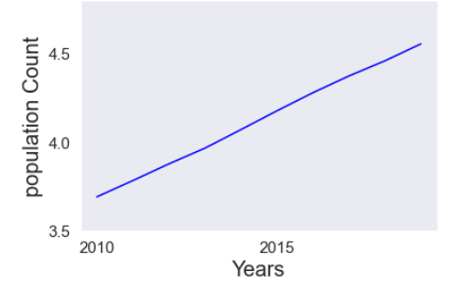
Population 2010-2019
Steady increase of population could be a factor for the increase in the price of homes.
2010 - 2015 ~ 480K increase in population
2015 - 2019 ~ 380K increase in population

Slide 7
Analysis
Homes sales in Austin are increasing yearly
Home sales increased 2.27% from 2018 to 2019 and jumped to 10.20% from 2019 to 2020
Population increased 3.5% to 4.5% annually since 2010

Slide 8
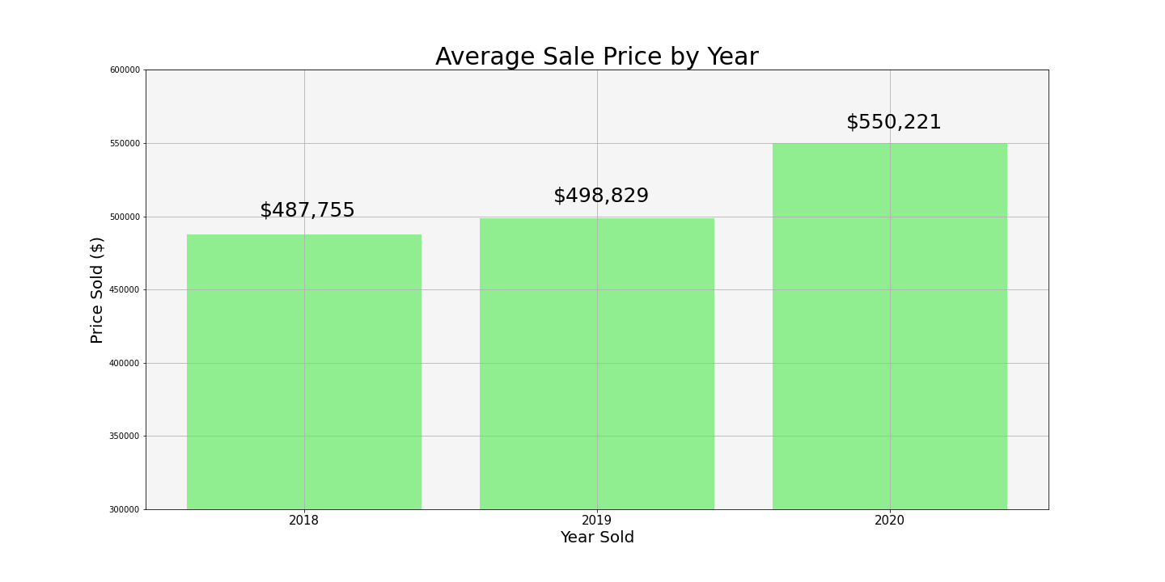

Slide 9

“What are different trends in the housing market?”
To answer that we look at a few key areas:
What type of houses are being purchased?
Where are homes being purchased?
What time of the year are homes bought and sold?

Slide 10
Analysis
Market is primarily affected by:
Location
North-West
North-East
South-West
South-East
Living Space Square Footage
Lot Space Square Footage
Number of Bedrooms
Number of Stories

Slide 11
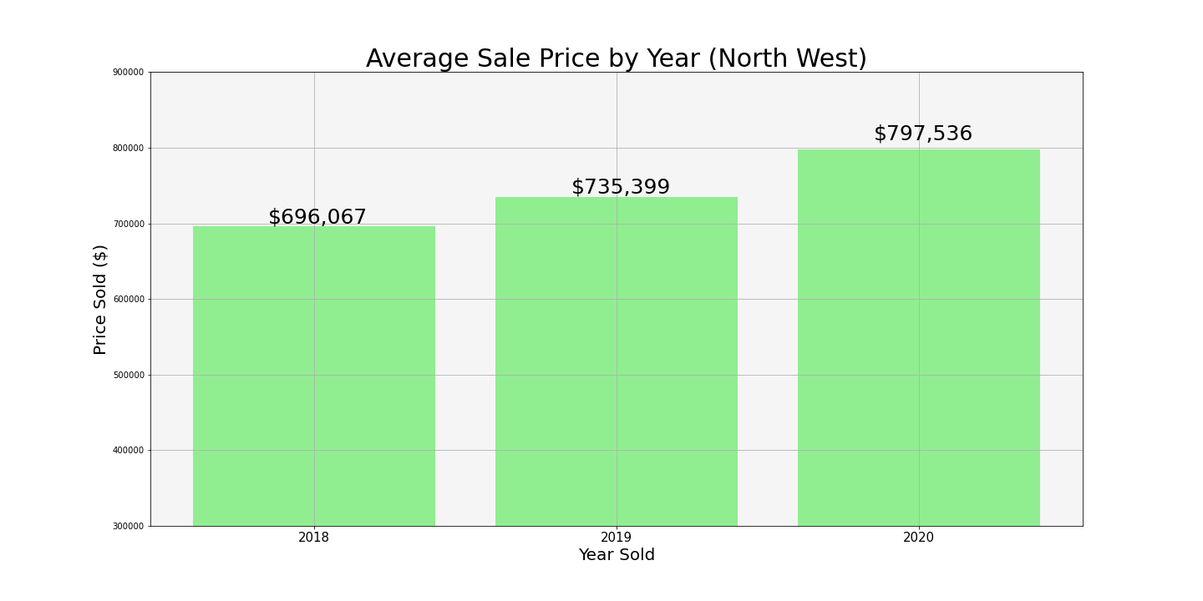
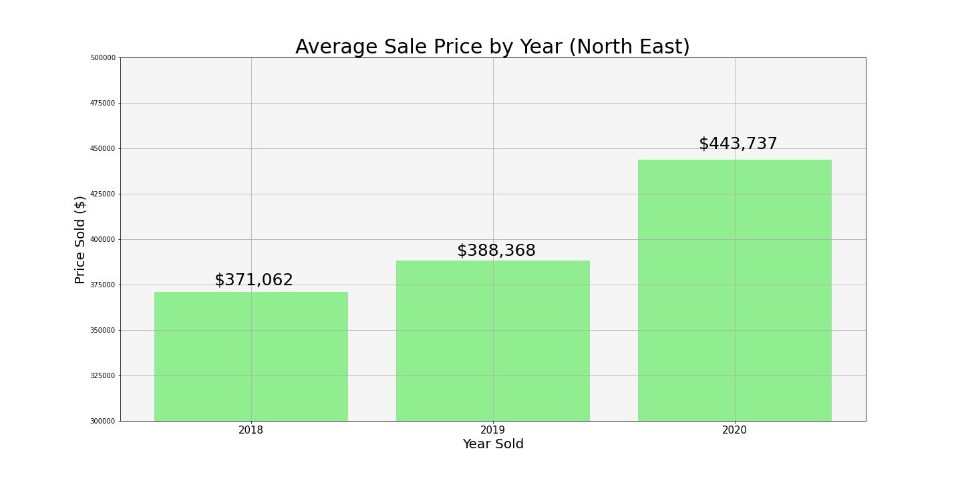
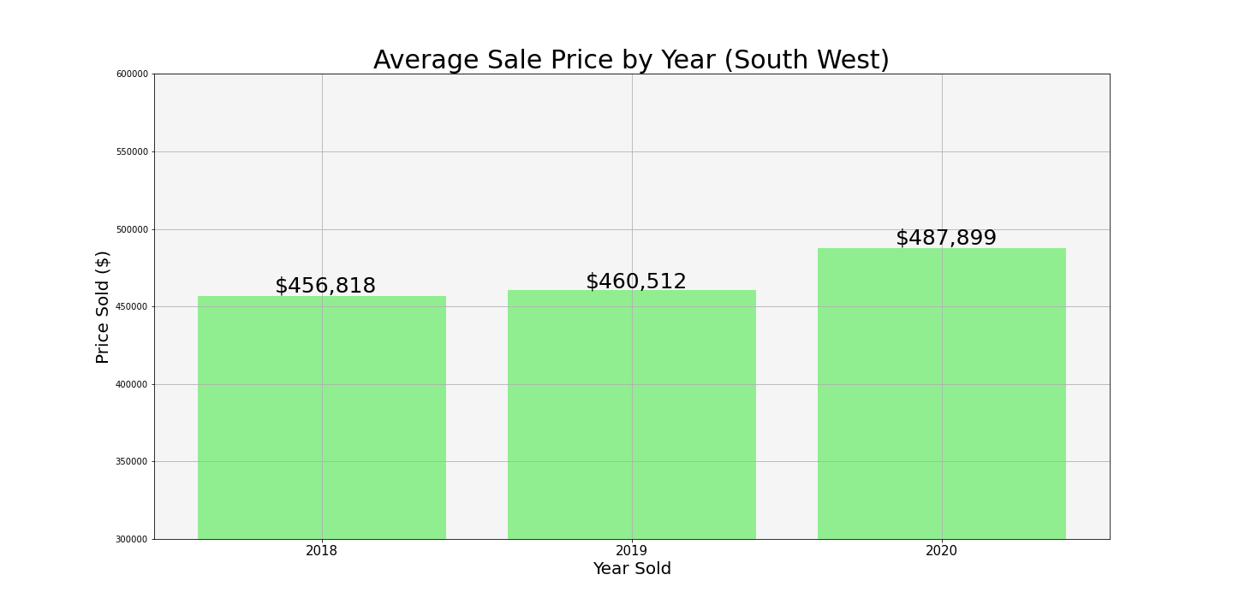
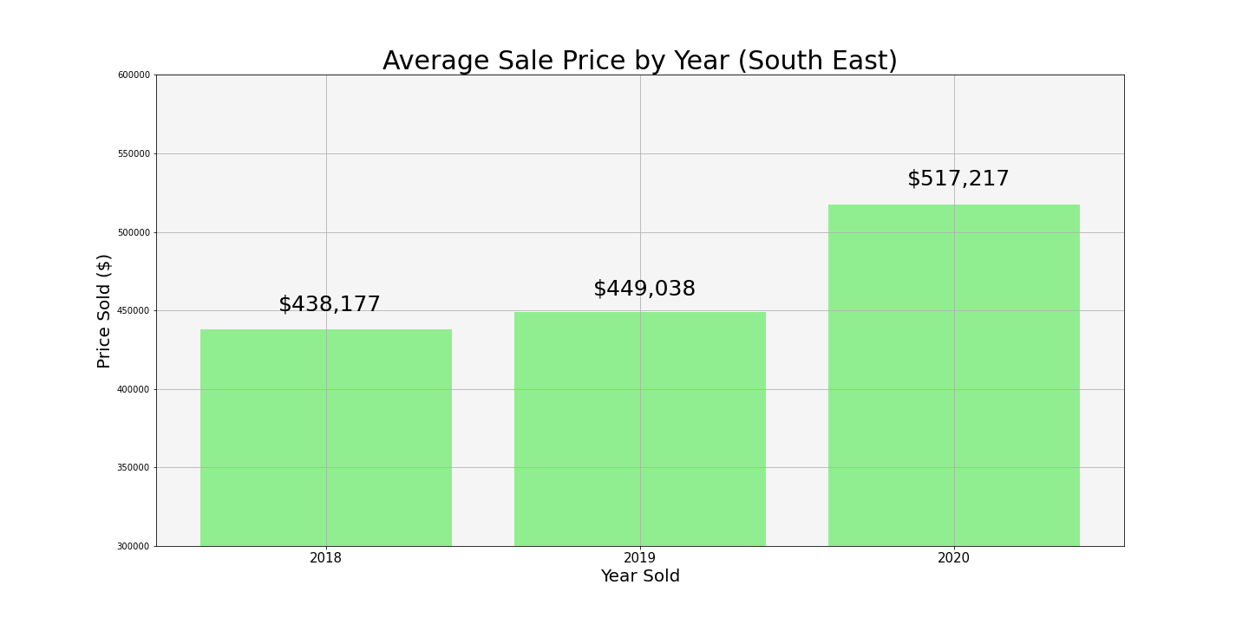

Slide 12
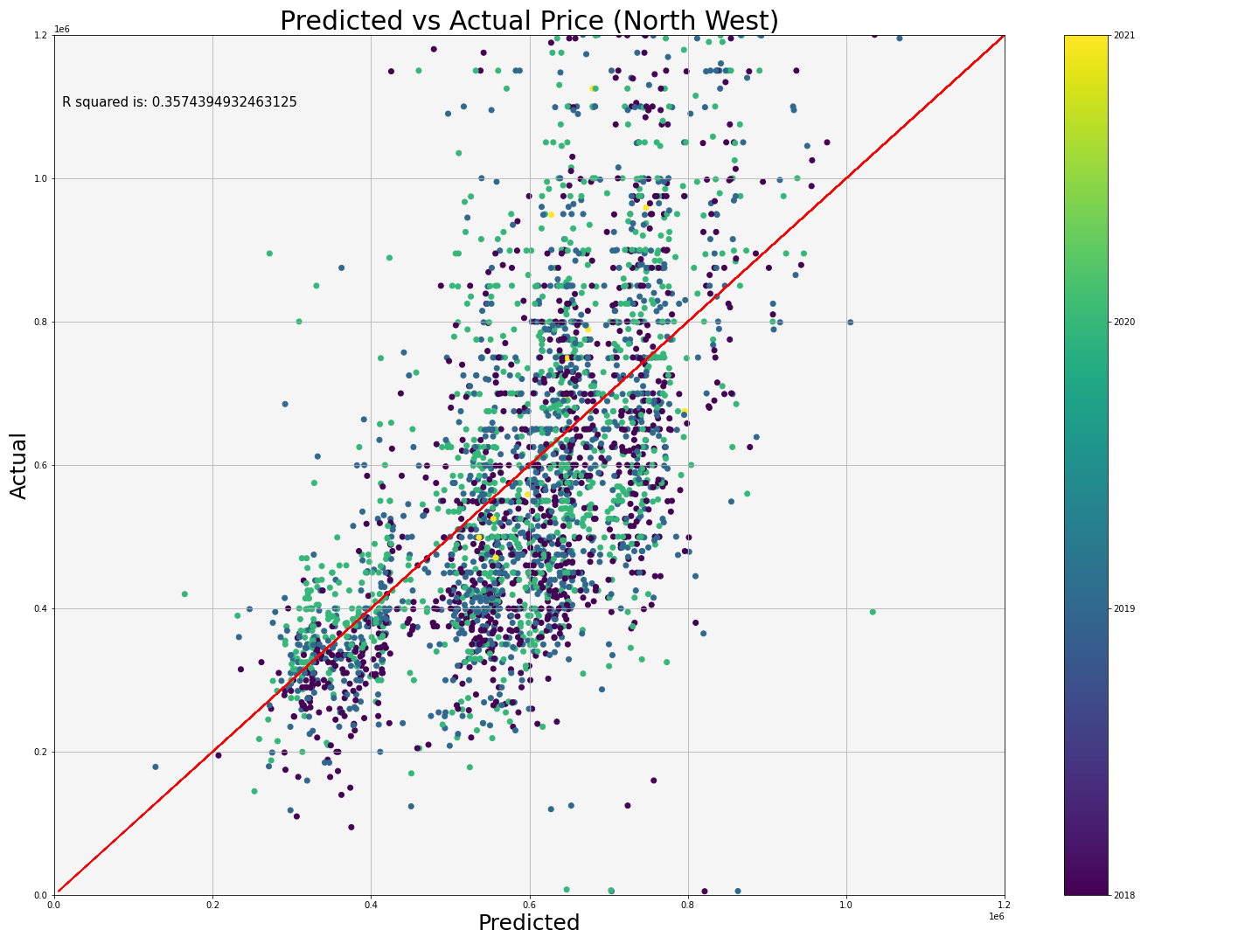
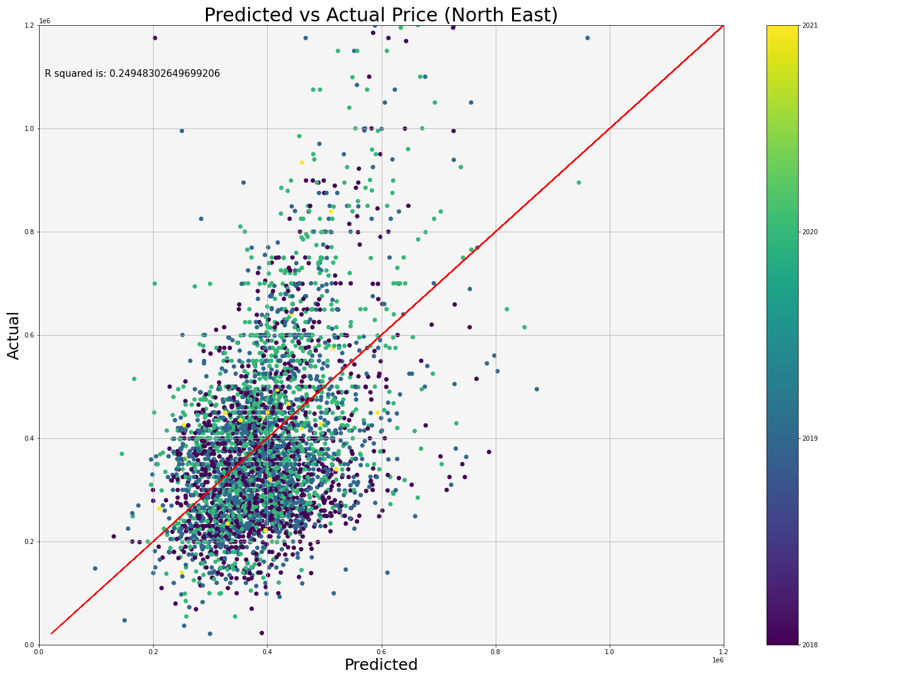
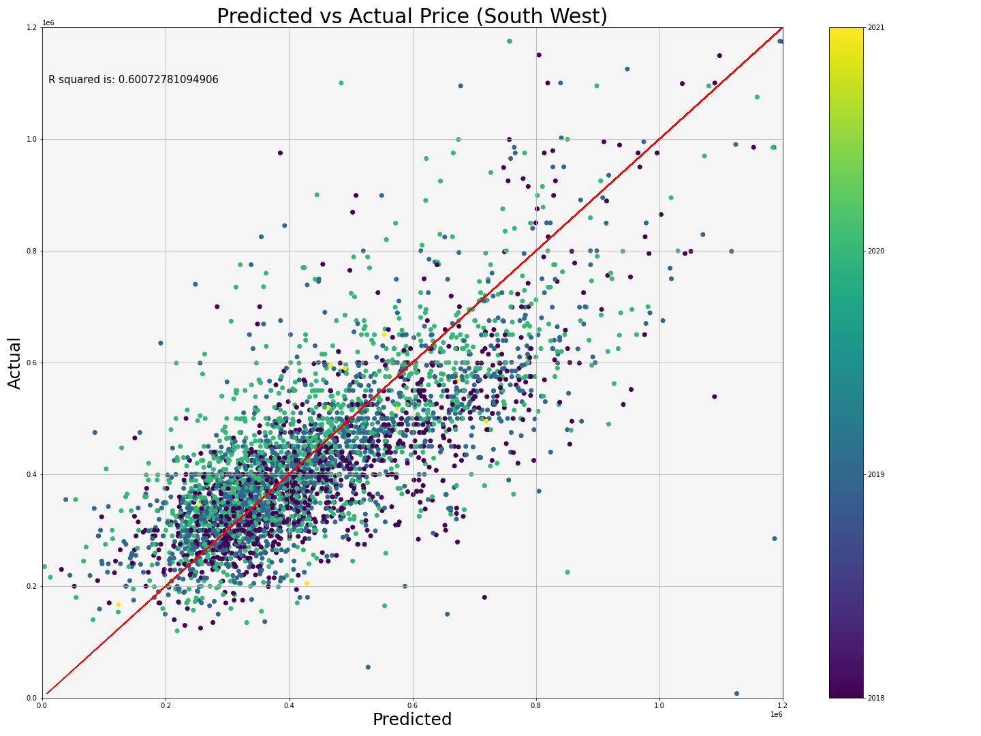
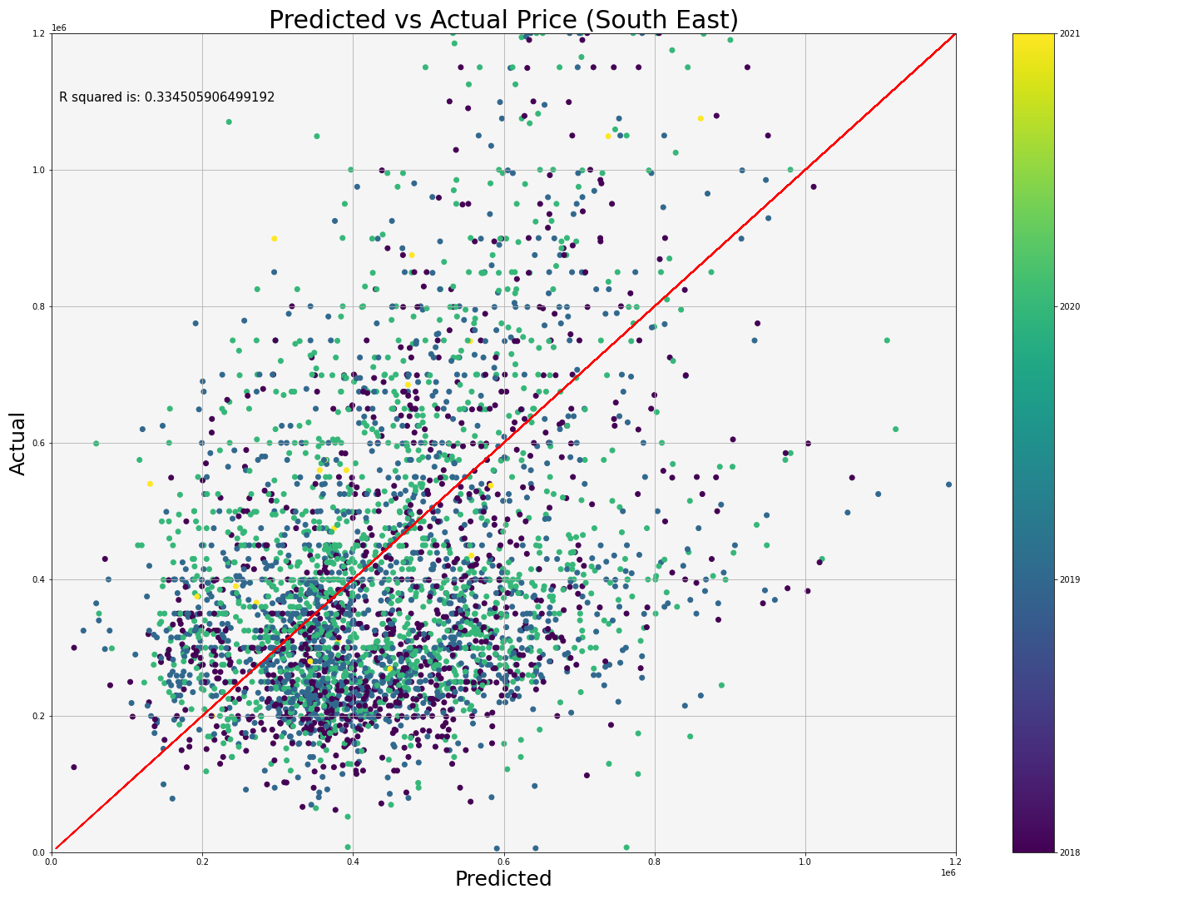

Slide 13


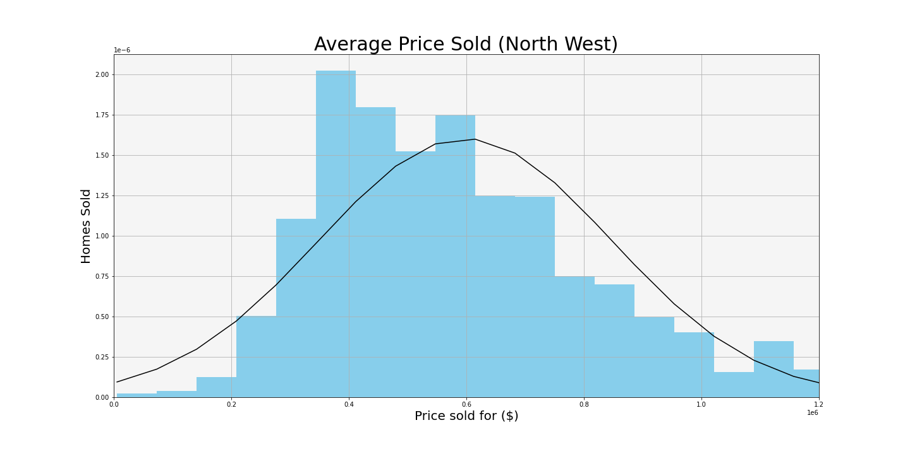

Slide 14
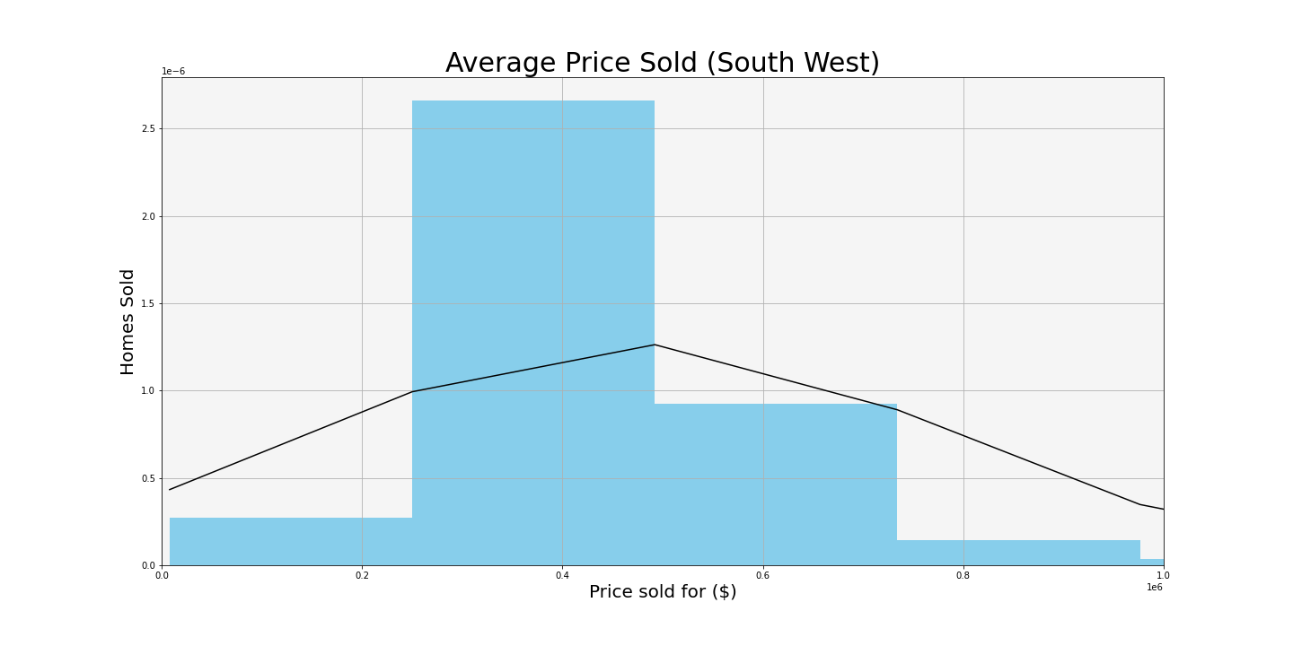

Slide 15
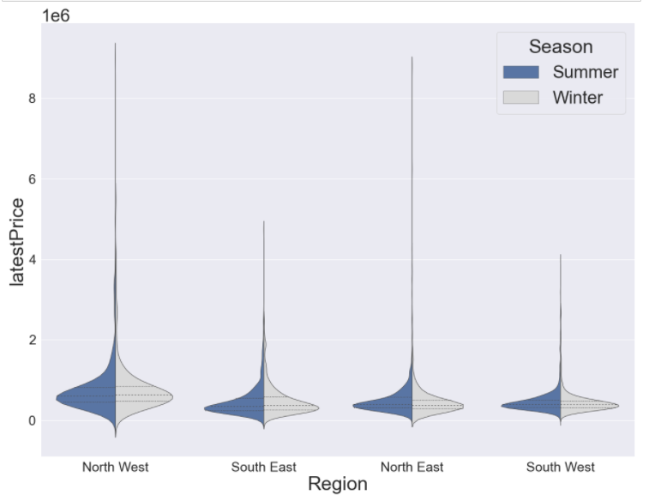
Prices vs. Region

Slide 16
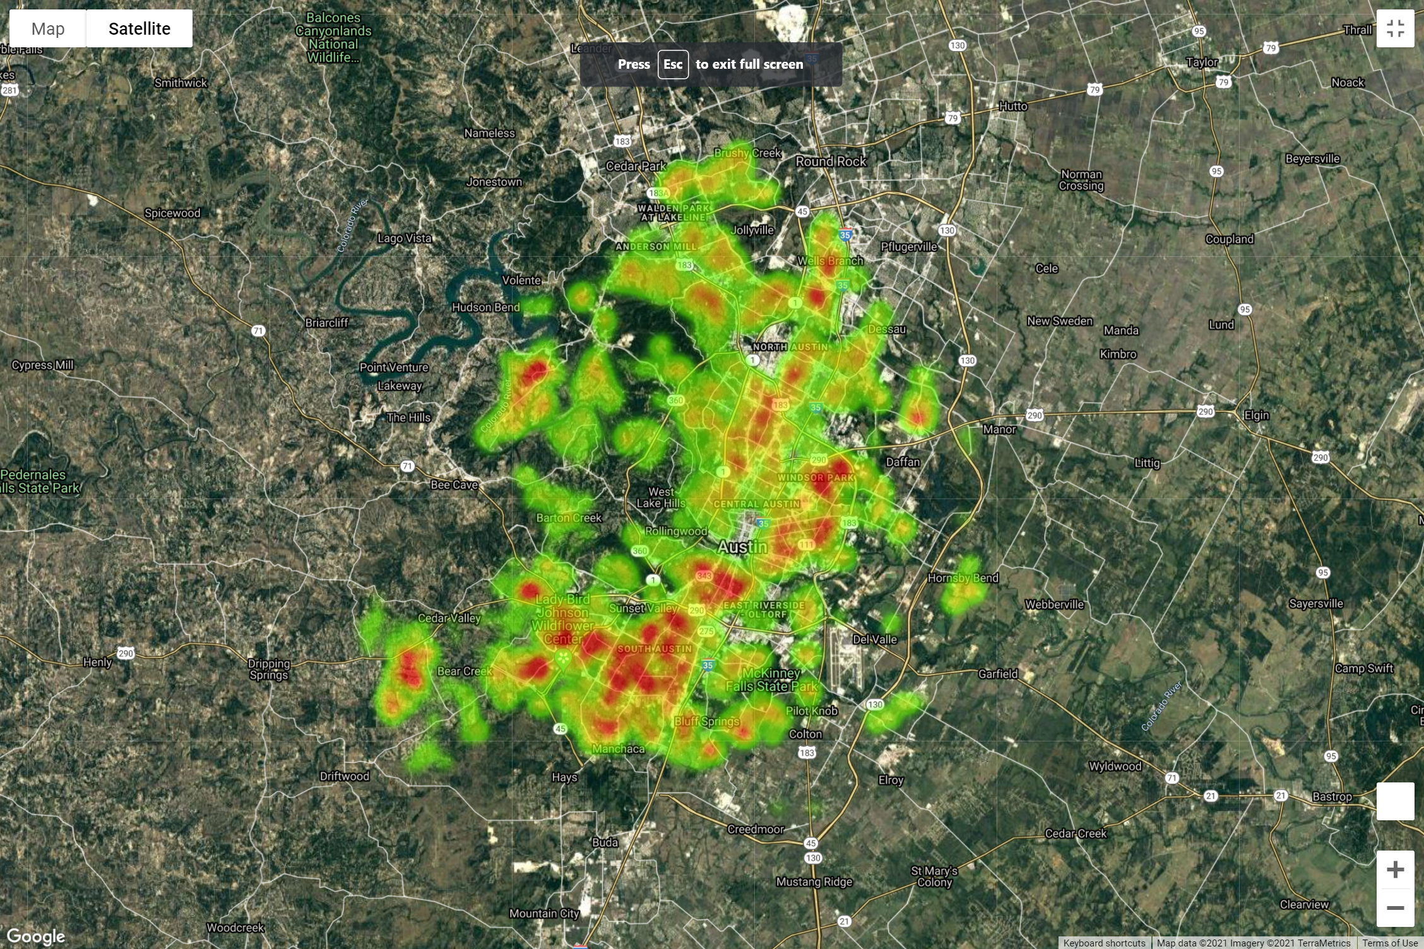
Heatmap by sales price
2020
Click to see who is correct
Notes:
Hyperlink will work if you have anaconda prompt open, if you have previously opened it and run the kernel it should work without having to do so.

Slide 17
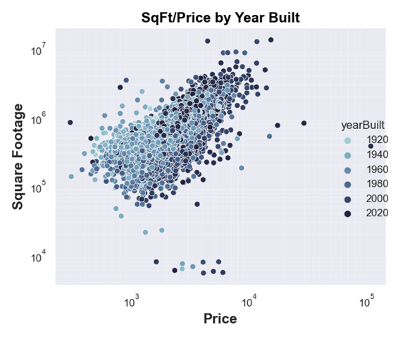
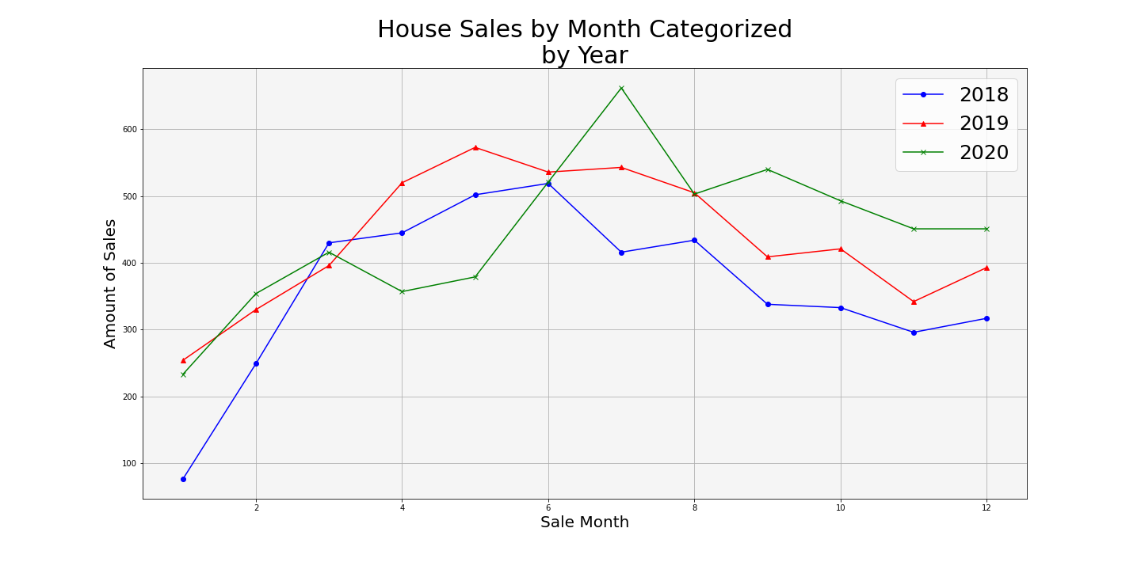
Actionable Insights
Investment/Buyer Strategies:
Single family homes make up the vast majority of all homes sold in Austin
Investors should buy during the winter months, ideally in Jan.
Sell during the peak months in the late 2nd and 3rd quarters.
The year the home was built has an impact on the price and square footage.

Slide 18
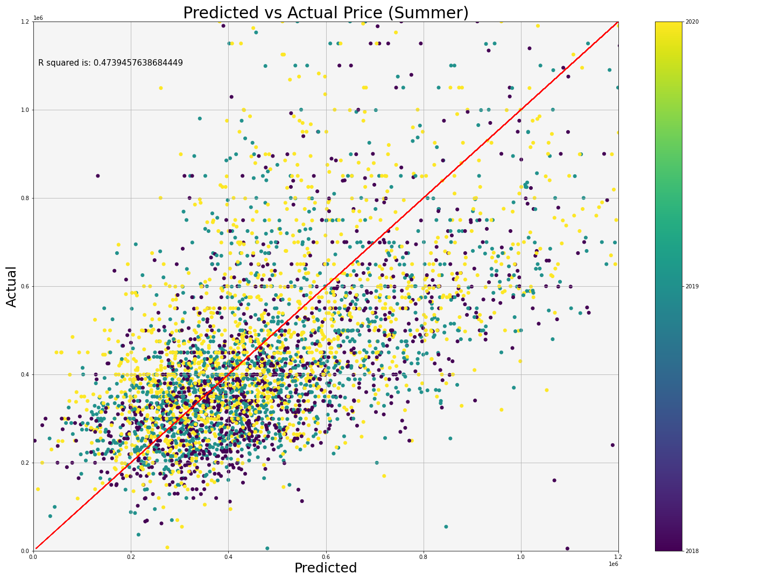
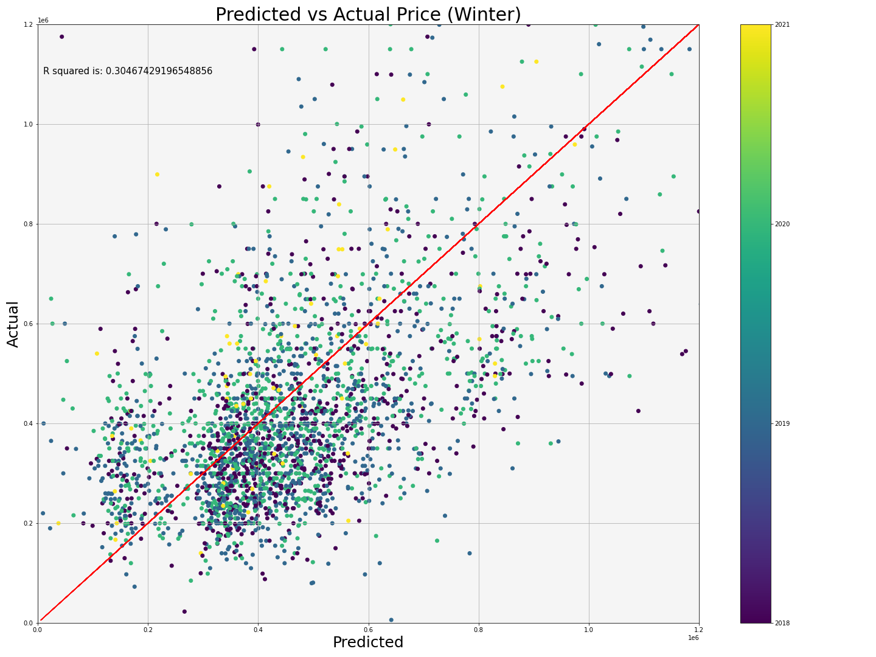
Actionable Insights
Seller Strategies:
Current owners, do not list homes during winter as sales are less likely to occur.
Summer months attracted more buyers and have more predictable prices
Austin’s home sales are increasing at a lower rate than the population growth of the city

Slide 19
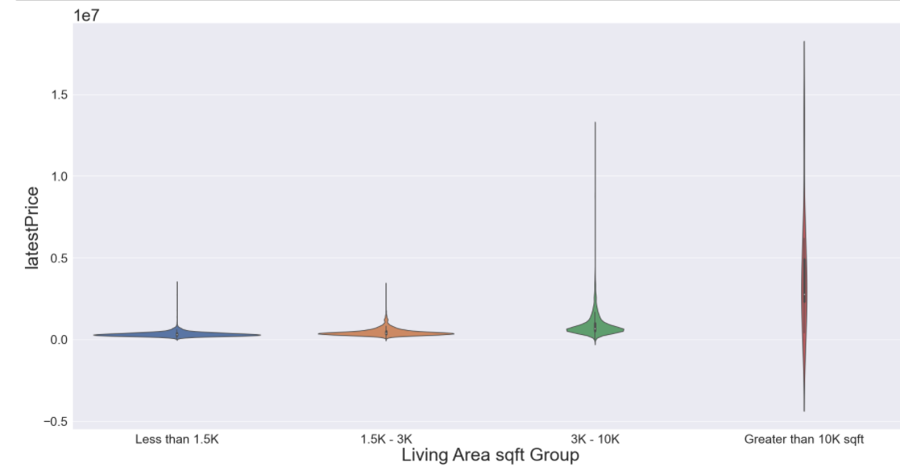
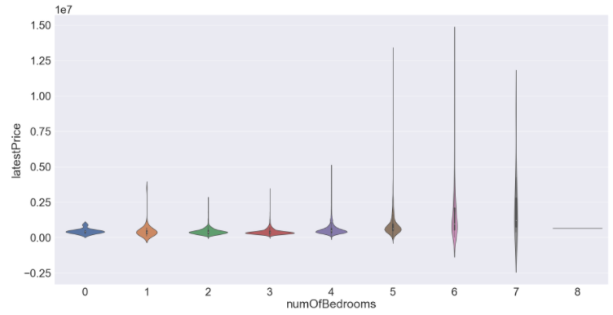
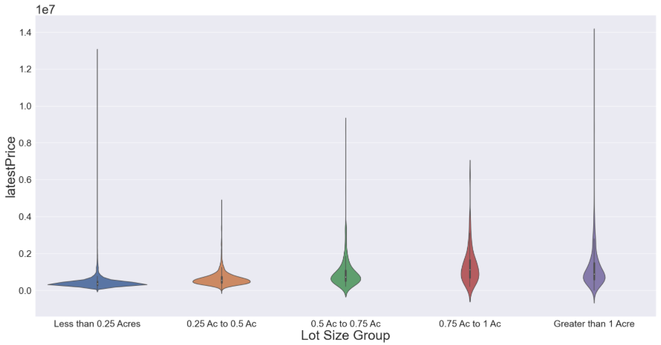
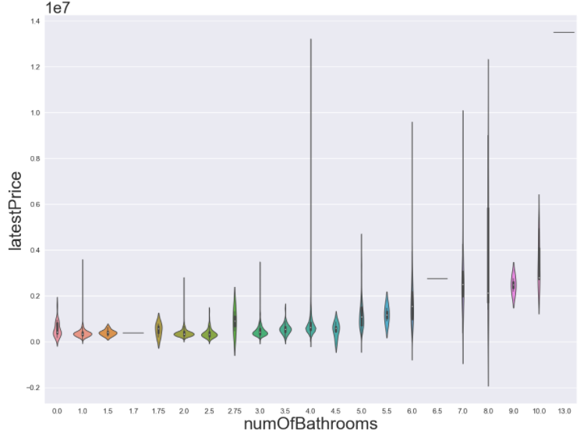

Slide 20
Limitations and Future Work
Data
Did not include list dates, initial sales price, length of time on the market, substantial data from 2021, total count of inventory, average length of time on the market, …..
With unlimited time and budget we would conduct a more thorough analysis on the market to identify the best possible location, time, etc.

Slide 21
References
Kaggle
https://www.kaggle.com/ericpierce/austinhousingprices?select=austinHousingData.csv
Google Maps api
https://cloud.google.com/maps-platform/
Census
https://www.census.gov/data/datasets/time-series/demo/popest/2010s-counties-total.htm

Slide 22
Q/A

